Slide 1



Chicago City Crime Data
Prediction using Cluster Analysis
Akash Dhotre
Mansi Padalia
Vaibhav Shanbhag

Slide 2
Data Insights
Dataset: https://data.cityofchicago.org/Public-Safety/Crimes-One-year-prior-to-present/x2n5-8w5q/data
Size: 263,803 observations with 17 variables
Variables:
Case #, Date Of Occurrence, Block
IUCR – Codes to classify criminal incidents
Primary Description, Secondary Description, Location Description, Domestic
X &Y coordinates, Latitude, Longitude, Location
Arrest – Flag indicating the criminal arrest status
Beat, Ward – Boundaries of Police Stations

Slide 3
Data Exploration and Processing
Remove duplicate case numbers
Remove records with missing latitude
Remove records with missing ward number
Remove illogical values, like ‘CASE#’
Convert dates from FCT to POSIXct
Split date column into date & time column
Add day & month column
Bucket crime types into defined types

Slide 4
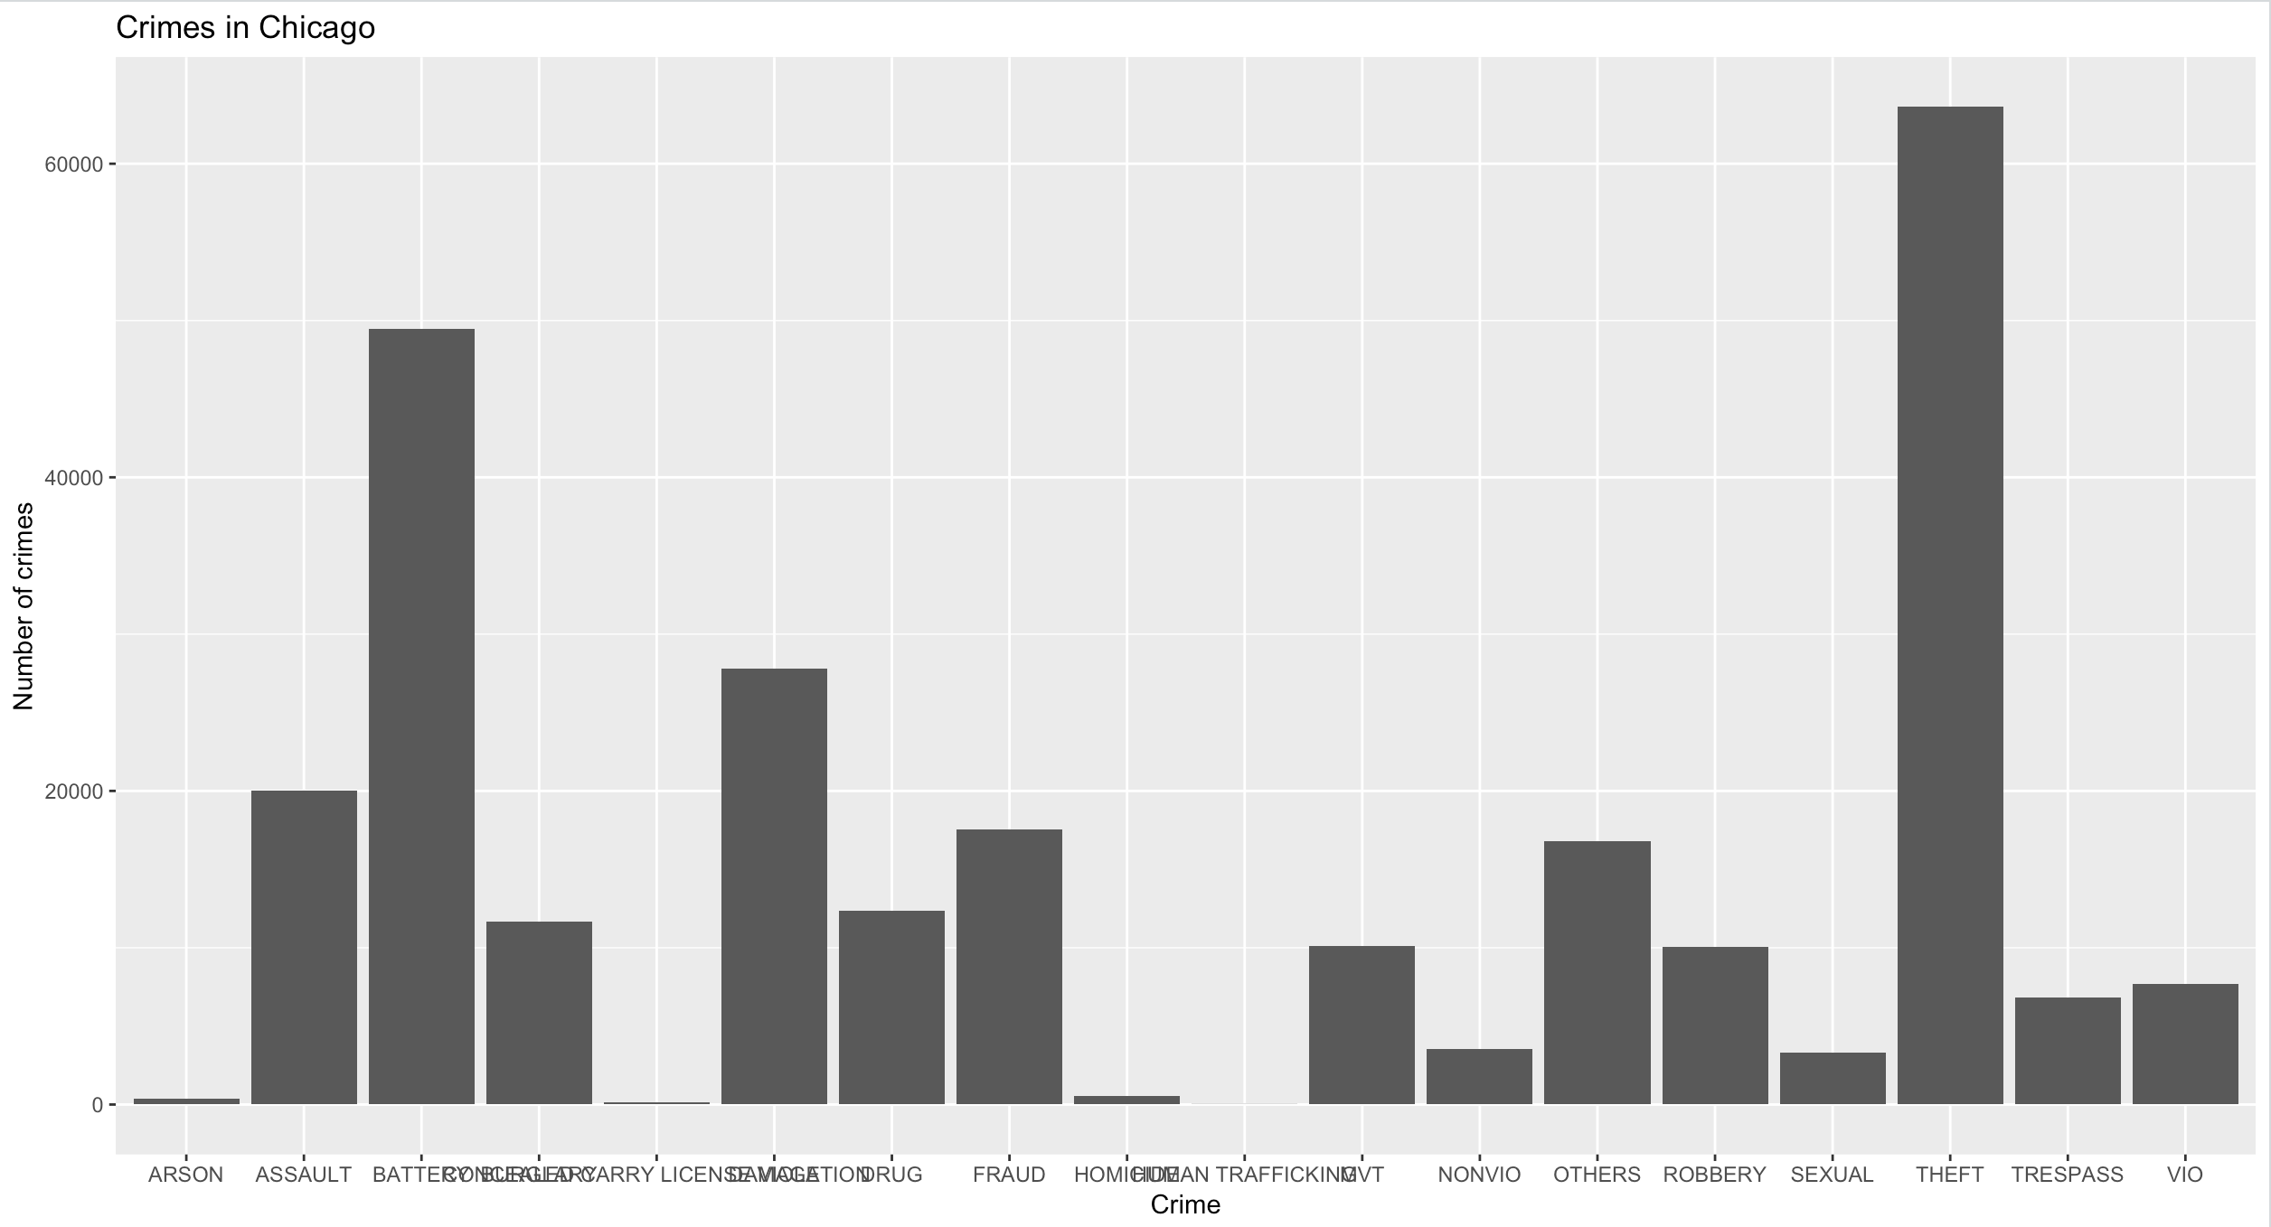
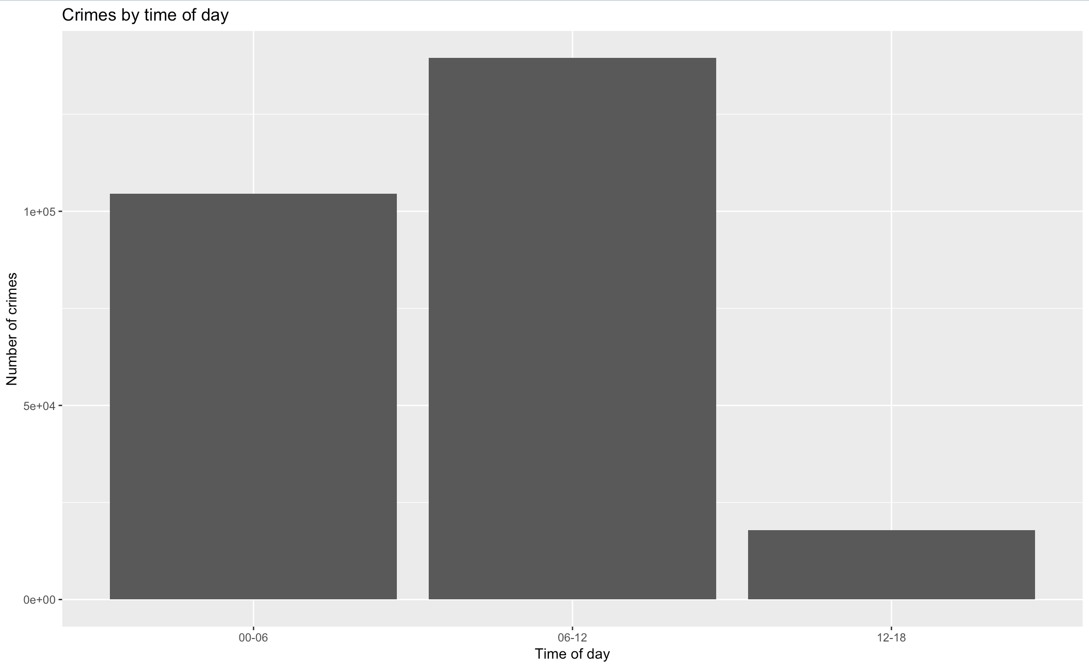
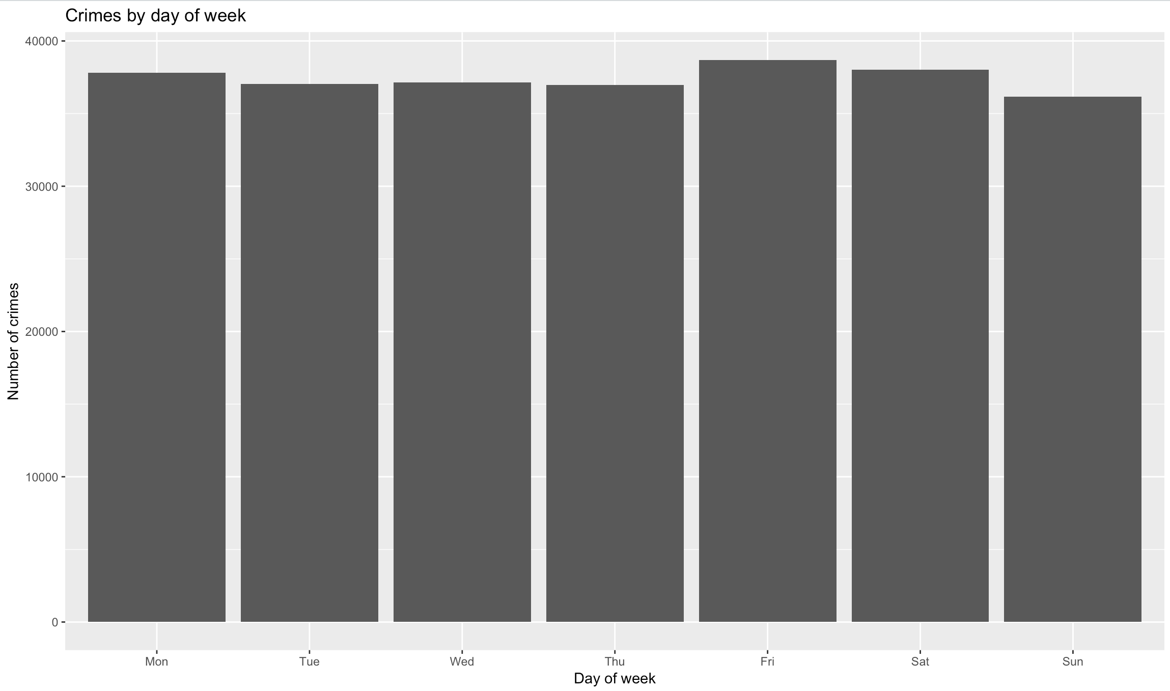
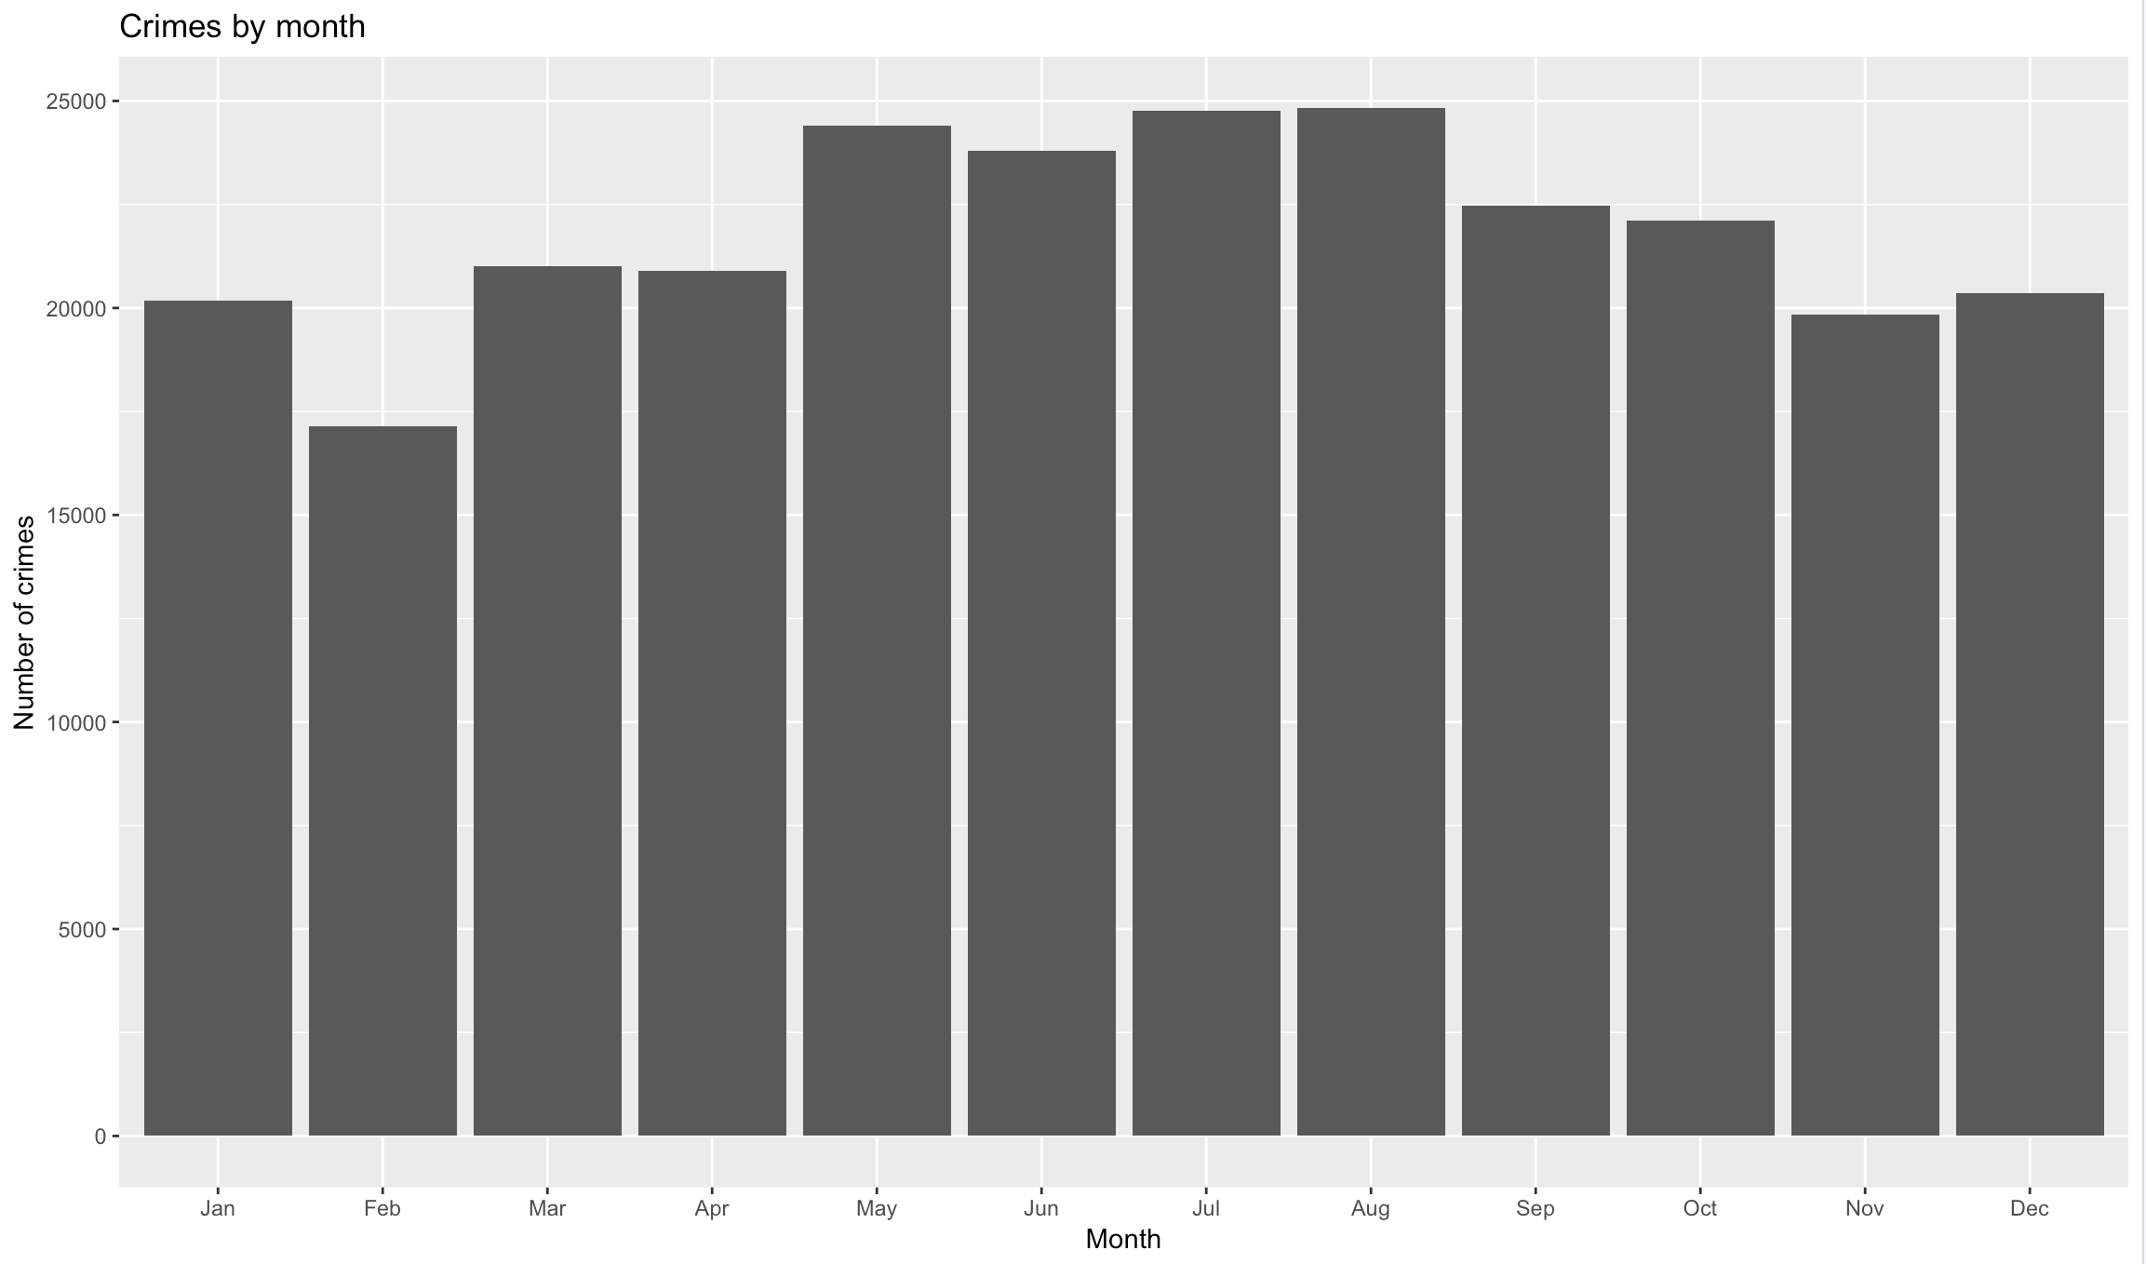
Data Visualization

Slide 5
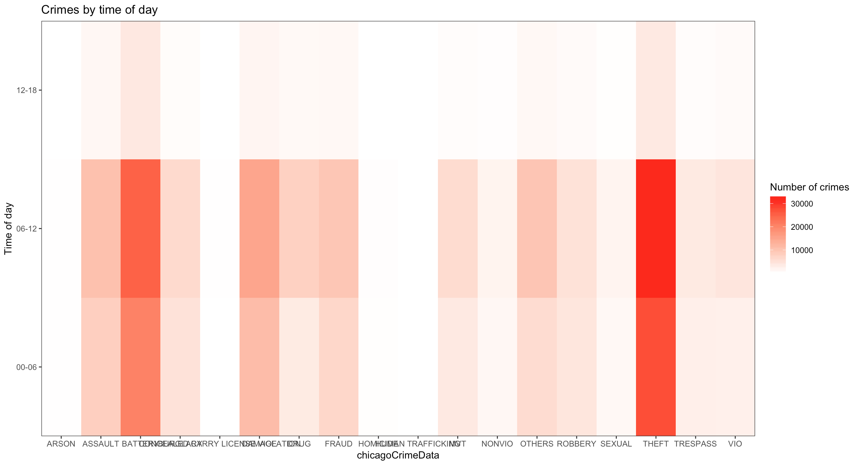
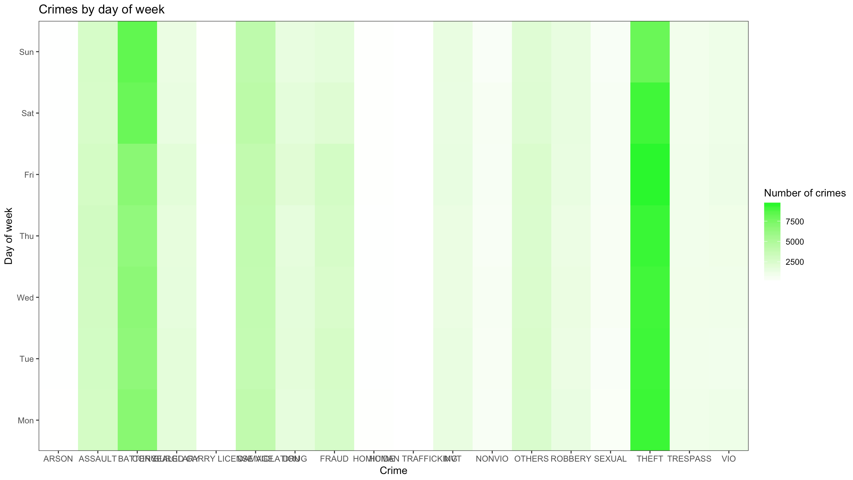
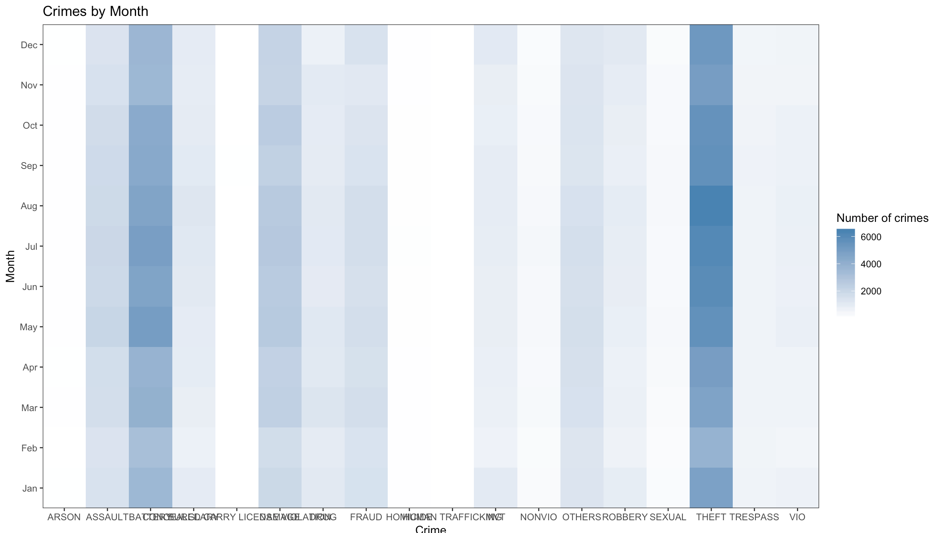
Data Visualization

Slide 6
Our Approach
Find Optimal number of clusters for k-means
Apply k-means with derived value for ‘k’
For each cluster – predict using C50 decision tree
Comparing results against a random sample of the data using knn prediction algorithm

Slide 7
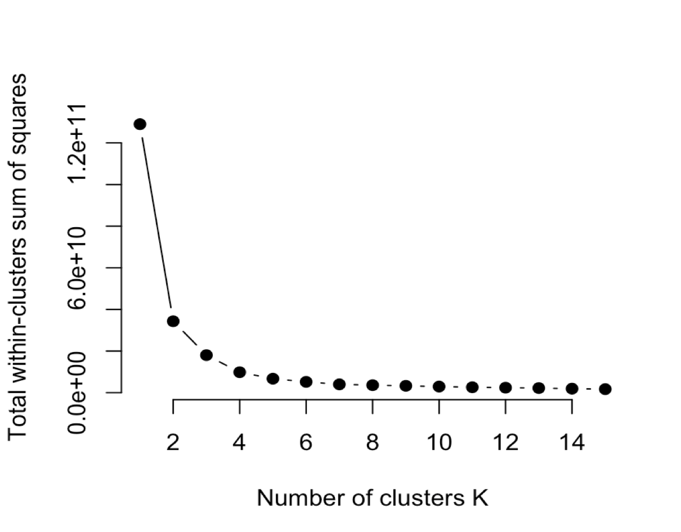
Optimal Number of Clusters
Elbow Method
Total intra-cluster variation
Total within-cluster sum of square
For a range of k, calculate the total within-cluster sum of square
Plot the curve of wss vs k
Location of a bend

Slide 8
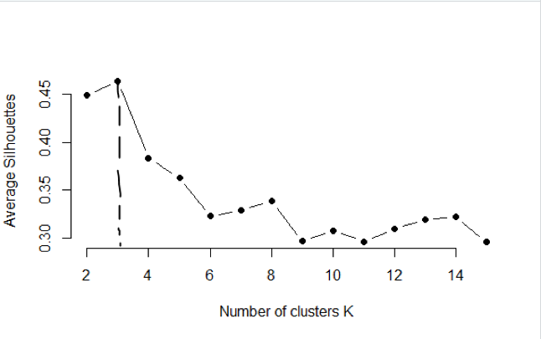
Optimal Number of Clusters
Average Silhouette Method
Measure of each point in one cluster → points in the neighboring clusters
Range → [-1, 1]
For a range of k, computes average silhouette of observations
Plot the curve of avg.sil vs k
Location of the maximum

Slide 9
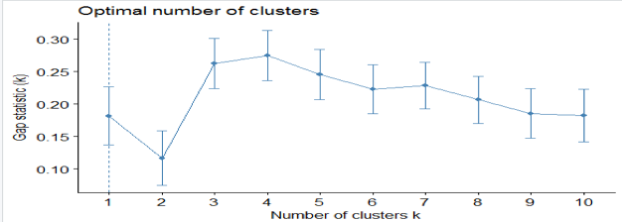
Optimal Number of Clusters
Gap Statistic Method
Total within intra-cluster variation
Expected values under null reference distribution
Plot the curve of gap statistic vs k
Value of the maximize the gap statistic

Slide 10
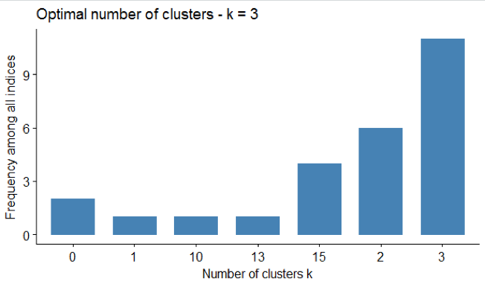
Optimal Number of Clusters
NbClust() function
30 indices for determining the relevant number of clusters
Proposes to users the best clustering scheme
Includes gap statistic, silhouette method and 28 other indices (references)
Location of maximum frequency

Slide 11

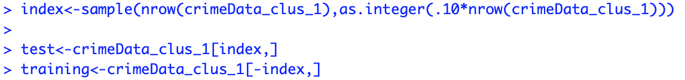

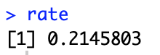
K-means Clustering
Optimal value of k=3
crimeForCluster → IUCR, Arrest, Beat, Ward
Accuracy → 78.55%

Slide 12
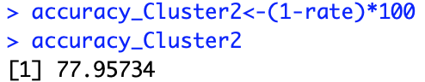
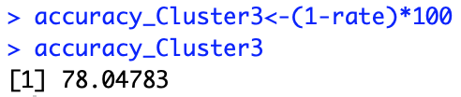

K-means Clustering
C50 on Each Cluster

Slide 13
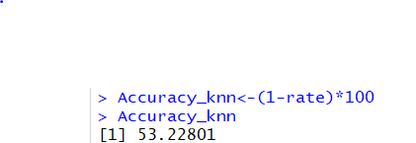
Random Sample
KNN Prediction
Random Sample of 33% original data
KNN, with k = 3

Slide 14

Questions

Slide 15
References
https://www.datanovia.com/en/lessons/determining-the-optimal-number-of-clusters-3-must-know-methods/#elbow-method
https://scikit-learn.org/stable/auto_examples/cluster/plot_kmeans_silhouette_analysis.html
http://www.sthda.com/english/wiki/print.php?id=239
Charrad et al., 2014

Slide 16
Thank You

